Slide 1
Supporting SEMH Pupils: Understanding the communicative Functions of Behaviour
Dr Scott I-Patrick
Educational Psychologist
High-Wycombe Area Hub

Slide 2
SEMH and Challenging Behaviour
SEMH refers to the social, emotional, and mental well-being of children and young people.
Challenging behaviour in pupils is closely linked to SEMH.
Every challenging behaviour serves an underlying need that even the pupil might not be able to explain.
Effective solutions for supporting pupils hinge on the quality of the relationship between the teacher and pupils.
Teachers need to be aware of the impact of context on pupils' behaviour.
Adapting and differentiating the curriculum content effectively can support pupils who exhibit challenging behaviour.
Notes:
Link between SEMH and challenging behaviour
can affect a pupil's ability to learn and function in school.
Challenging behaviour can be a symptom of underlying SEMH issues.
Understanding the communicative function of behaviour is crucial to supporting pupils who exhibit challenging behaviour.

Slide 3
Uncovering the Underlying Needs
Every challenging behaviour serves an underlying need that even the pupil might not be able to explain.
Understanding the communicative functions of behaviour is crucial to addressing challenging behaviour.
Teachers need to identify the underlying needs that drive challenging behaviour to support pupils effectively.
Notes:
Uncovering the underlying needs requires teachers to listen actively and observe pupils' behaviour closely.
Pupils who exhibit challenging behaviour might be experiencing underlying issues such as anxiety, trauma, or stress.
Addressing the underlying needs can help prevent challenging behaviour from occurring in the future.

Slide 4
The Importance of Teacher-Pupil Relationships
Building trust and understanding pupils' strengths and weaknesses is crucial to supporting pupils effectively.
Effective solutions for supporting pupils hinge on the quality of the relationship between the teacher and pupils.
Positive relationships can prevent challenging behaviour and improve pupils' academic outcomes.
Notes:
Building positive relationships with pupils requires active listening, empathy, and respect.
Understanding pupils' strengths and weaknesses can help teachers adapt and differentiate the curriculum content effectively.
Positive relationships can also promote a sense of belonging and well-being, which can have a positive impact on pupils' social, emotional, and mental health.

Slide 5
Maximizing Positive Affect, Minimizing Negative Affects
The central executive concept states that we are innately programmed to:
maximize positive affect,
minimize negative affects, and
minimize the inhibition of affect.
A pupil's ability to function effectively is dependent on these factors being in place.
Understanding the impact of context on pupils' behaviour and supporting them appropriately can help promote positive affect and minimize negative affects.
Notes:
Positive affect includes emotions such as happiness, excitement, and joy, while negative affects include emotions such as anxiety, sadness, and anger.
A lack of positive affect or an excess of negative affects can affect a pupil's ability to learn and function in school.
Supporting pupils appropriately can help promote positive affect and minimize negative affects, leading to better academic outcomes and improved social, emotional, and mental well-being.

Slide 6
The Role of Context and Biography in Pupil Behaviour
The impact of context amplified by biography can trigger negative affects and affect a pupil's behaviour.
Teachers need to be aware of the impact of context and biography on pupils' behaviour to support them appropriately.
Understanding pupils' contexts and biographies can help teachers adapt and differentiate the curriculum content effectively.
Notes:
Context can include factors such as family situations, social dynamics, and school environments.
Biography can include factors such as past experiences, cultural background, and individual characteristics.
Teachers who are aware of the impact of context and biography on pupils' behaviour can support pupils effectively by providing appropriate support and adapting the curriculum content.

Slide 7
Decoding Behavioural Messages
Challenging behaviour is often a symptom of underlying emotions that pupils might not be able to express effectively.
Understanding the underlying emotions behind challenging behaviour is crucial to addressing it effectively.
Teachers can address challenging behaviour by providing appropriate support, building positive relationships, and adapting and differentiating the curriculum content.
Notes:
Teachers can decode behavioural messages by observing pupils' behaviour closely, listening actively, and considering their context and biography.
Addressing the underlying emotions behind challenging behaviour can help prevent it from occurring in the future and promote positive well-being for pupils.
Providing appropriate support might include offering counseling, academic support, or opportunities for pupils to express themselves creatively.

Slide 8
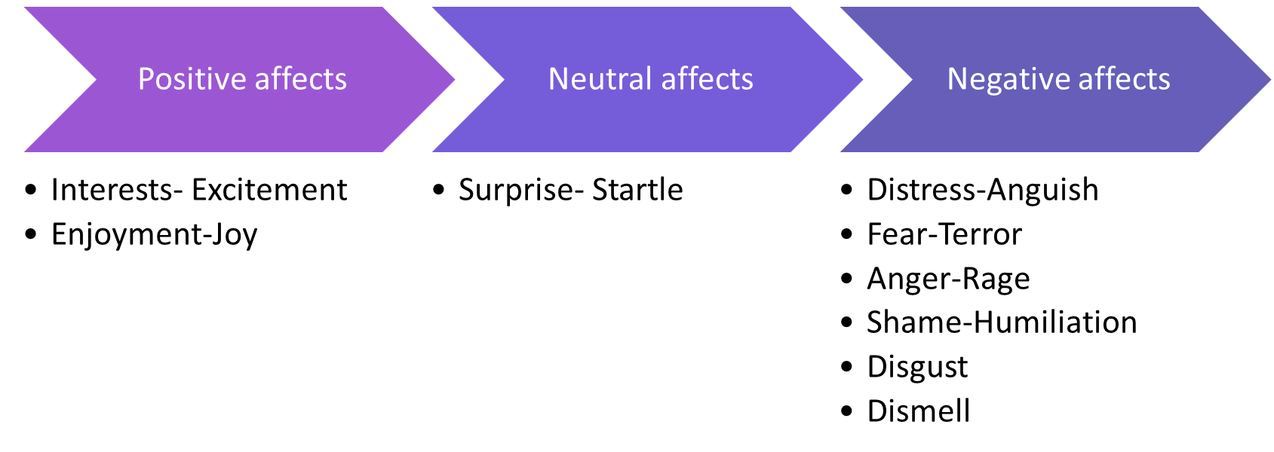
Theory of Affect Script
Notes:
Examples of what might trigger these affects include:
Pupil’s senses picking up something to big, too loud, or too fast, and/or feeling threatened (fear-terror).
Response triggered when too much has been happening for too long, or when overwhelmed (distress-anguish).
When that too much finally stops happening or a reward is received (enjoyment-joy).
When senses encounter a novel stimulus that is just right or discovering something new (interest-excitement).
Experiencing an unexpected event (surprise-startle).
Being treated unfairly (anger-rage).
Encountering something unpleasant (disgust).
Feeling exposed (shame-humiliation).
Select one or two examples- don’t go through them all
A pupil's biography can intensify their reactions to situations. This is particularly true when pupils are confronted with challenges that have persisted for a long time.
Pupils may use presenting behaviours as a way to maximise positive affects and avoid negative affects triggered by persistent challenges. For example, a pupil who has experienced neglect may seek attention through disruptive behaviour, as a way of compensating for the lack of attention they received at home.
By understanding the role of biography, we can begin to recognise the underlying needs of pupils and respond to them in a more targeted way.
Most of the experiences of interest and joy that get impeded have to do with interpersonal engagement with others. So, think of shame as an interpersonal/interactional affect.
Once positive affect is impeded, the affect shame focuses attention on the impediment that triggered the negative affect.
Now, the thing is what we see in the moment of shame is something in us that isn’t perfect – scripted emotions/biography.
Pupil’s draw on scripts built up over time to help minimise the destructive impact of negative affects…

Slide 9
The Central Executive
Central Executive
Maximise positive affect
Minimise negative affect
Minimise the inhibition of affect
Silvan Tomkins - 9 innate affects hard-wired into our autonomic nervous system from birth.
We have no control over these and they are triggered by stimulus in our environment and/or thoughts.

Slide 10
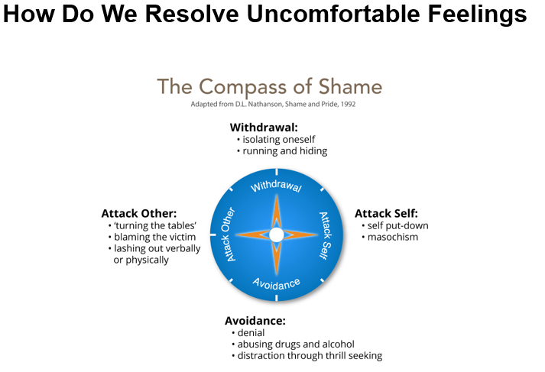
Compass of Shame Scripts
Notes:
The four poles of the compass of shame are:
Withdrawal (the pupil retreats into themselves, switch off from learning and not attend lessons).
Avoidance (the pupil avoids the situation altogether, be the class clown, focus on other aspect of their lives, take risks, use drugs etc.).
Attack others (the pupil blames others, put others down, belittle value of work, diminish and bully others etc.).
Attack self (the pupil blames themselves, put themselves down, they assume they are dumb etc.).
When pupils feel shame, they may draw on these scripts as a way of protecting themselves from further harm.
As educators, it's important to recognise the power imbalances that exist between staff and pupils and work to create a safe and trusting environment where pupils feel comfortable expressing their underlying struggles.

Slide 11
Tailoring Education to Pupil Needs
Adapting and differentiating the curriculum content based on pupils' strengths and weaknesses is crucial to supporting their success.
1
Understanding pupils' strengths and weaknesses can help teachers adapt and differentiate the curriculum content effectively.
2
Adapting and differentiating the curriculum content can help prevent challenging behaviour and promote positive academic outcomes.
3
Notes:
Adapting and differentiating the curriculum content can include using visual aids, offering additional support, or adjusting the pace of instruction.
Understanding pupils' strengths and weaknesses can help teachers identify areas where additional support is needed and promote a sense of success and accomplishment.
Adapting and differentiating the curriculum content can help prevent challenging behaviour by reducing frustration and promoting engagement and positive affect.

Slide 12
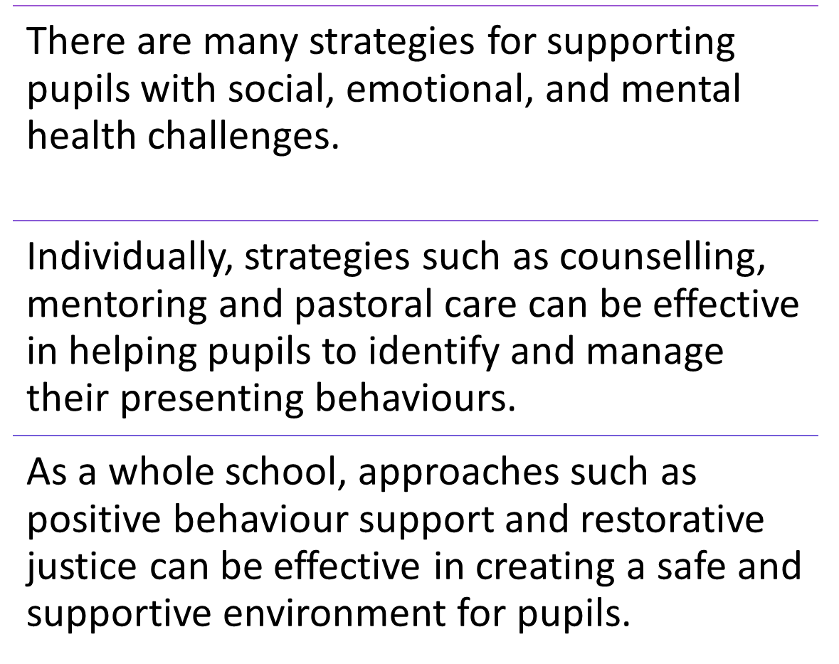
Supporting pupils and practical advice
Notes:
In addition to these strategies, educators can use the following practical tips to manage challenging behaviours:
Set clear expectations and boundaries for behaviour.
Use positive reinforcement to encourage positive behaviours.
Be consistent in your responses to behaviours.
Use visual aids and other non-verbal communication tools to support pupils with communication difficulties.
Use de-escalation techniques to manage situations where pupils are becoming agitated or upset.
Work collaboratively with other professionals, such as counsellors and therapists, to provide comprehensive support to pupils.
Provide opportunities for pupils to express their feelings and concerns in a safe and supportive environment.
Create a risk-tolerant learning zone.
Establish/communicate high expectations (not just high standards).
Example of communicating high expectations: As you learn this, mistakes are expected. Your mistakes help me to support you. Let’s make mistakes together!
Give feedback that focuses on process – things that they can control.
Example of when they struggle despite strong effort: I admire your persistence and I appreciate your hard work. It will pay off!
Example of when they struggle and needs help with strategies: Let’s do one together…
Example of when they are making progress: I see you using your strategies/tools/notes etc. keep it up!
Example of when they succeed with strong effort: I am very proud of you for not giving up and look what you have to show for it!
Focus on how tasks/activities are framed and how feedback is provided
Example of communicating learning goals: we are in the learning zone today; mistakes are our friends!

Slide 13
Thanks for listening

